Slide 1
Pocket pelvis

Slide 2
Pelvis

Slide 3
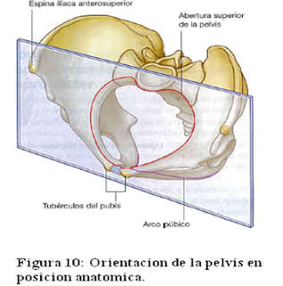
1
LEARNIG OBJETIVE: Understand the orientation of the pelvis: | HOW TO MEET THE OBJETIVE?
The orientation of the pelvis with the body in the upright position is with the anterior superior iliac spine and the superior part of the pubic symphysis in a vertical plane | The students will be able to manipulate the pelvis and thus locate its anatomical position with respect to the structures that surround it.

Slide 4
2
LEARNIG OBJETIVE: Define the bones and ligaments of the pelvis | HOW TO MEET THE OBJETIVE?
The pelvis is composed of the union of the sacrum bone with the 2 coxal bones (composed by the fusion of the ilium, ischium and pubis). In turn, the coxal bone articulates with the femur. These joints are secured by ligaments, some of them are: the sacrospinous ligament and the sacrotuberous ligament. | The student can observe the relationship between bone structures and ligaments, for a better understanding of the close relationship between structures, and thus understand their function.

Slide 5
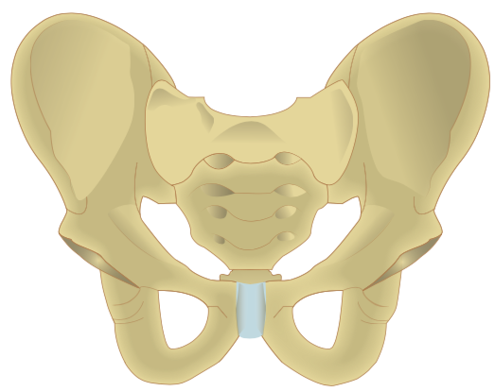
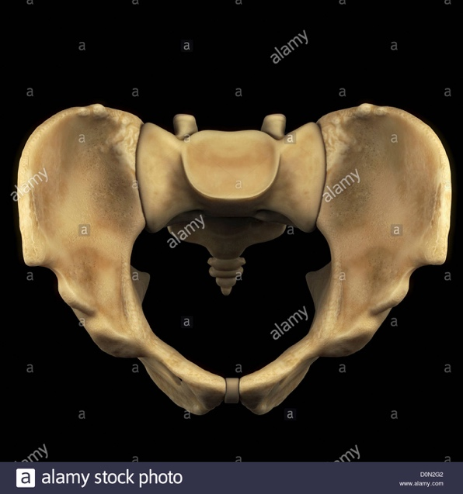
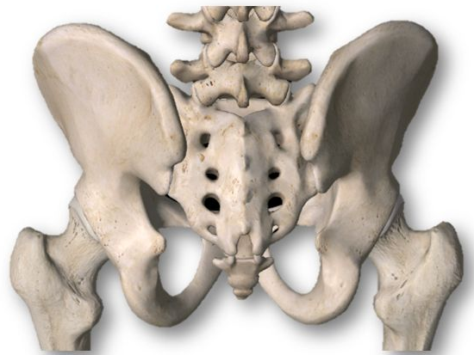
Anterior View of Male Pelvis | Superior View of Male Pelvis | Posterior View of Male Pelvis
Sacrum Coccyx Ilium: - Anterior superior iliac spine - Anterior inferior iliac spine - Crest Ischium: - Tuberosity Pubis: - Tubercle - Crest - Pubic Symphysis Femur | Coccyx Sacrum Ilium: - Anterior superior iliac spine - Anterior inferior iliac spine - Crest Ischium: - Ischium Spine Pubis: - Crest - Pubic Symphysis | Coccyx Sacrum Ilium: - Posterior superior iliac spine - Posterior inferior iliac spine - Crest Ischium: - Tuberosity - Ischium Spine Femur

Slide 6
ADDITIONAL INFORMATION • Sacrum: The Sacrum is a large, triangular fusion of five vertebrae and forms the posterosuperior wall of the pelvic cavity, wedged between the two hip bones. • Coccyx: The coccyx is a small triangular bone and is often asymmetrical in shape. It usually consists of four fused rudimentary vertebrae. • Ilium: The ilium is the superior border of the hip bone. Its ends project as anterior and posterior superior iliac spines, and it is palpable at the lateral end of the inguinal fold - Anterior superior iliac spine - Crest • Ischium: The Ischium is the inferoposterior part of hip bone, has a body and ramus. The body has upper and lower ends and femoral, posterior and pelvic surfaces. - Spine - Tuberosity • Pubis: The pubis is the ventral part of the hip bone and forms a medial cartilaginous pubic symphysis with its fellow. The body of the pubis occupies the anteriomedial part of bone. - Tubercle - Crest - Pubic Symphysis

Slide 7
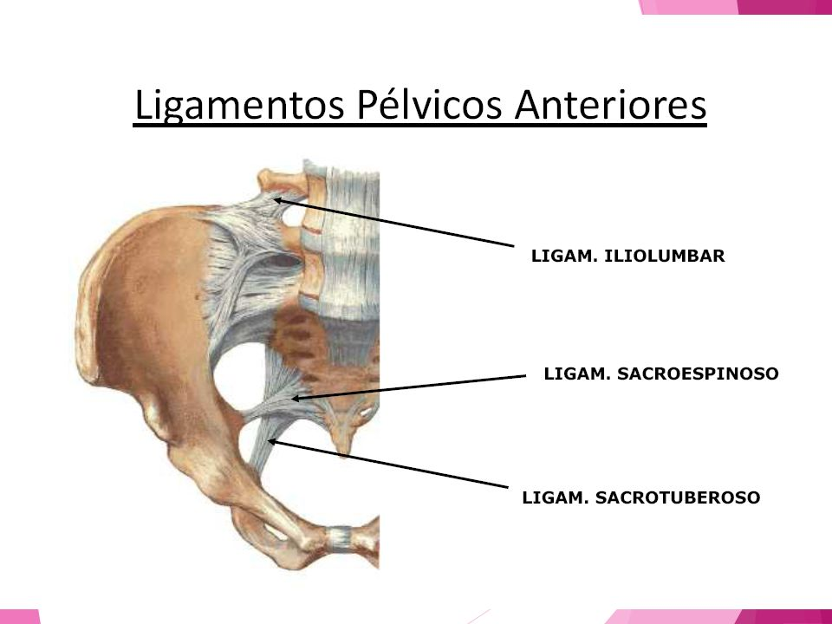
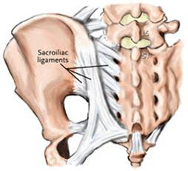
Anterior View of Male Pelvis | Superior View of Male Pelvis | Posterior View of Male Pelvis
b) Ligaments- membrane -Sacrospinous -Sacrotuberous -Obturator membrane | b) Ligaments- membrane -Sacrospinous -Sacrotuberous | b) Ligaments- membrane -Sacrospinous -Sacrotuberous

Slide 8
ADDITIONAL INFORMATION • Sacrospinous ligament: The sacrospinous ligament is a triangular ligament, his base is attached to the outer edge of the sacrum and coccyx, and the tip of the ligament attaches to the spine of the ischium. • Sacrotuberous ligament: The sacrotuberous ligament is attached by its broad base to the posterior superior iliac spine, the posterior sacroiliac ligaments (with which it is partly blended), to the lower transverse sacral tubercles and lateral margins of the lower sacrum and upper coccyx. • Obturator membrane: The obturator membrane attaches to the margins of the obturator foramen, almost completely closes the obturator foramen of the hip bone, except for the obturator canal, which serves as a passageway for the obturator blood vessels and nerves.

Slide 9
3
LEARNIG OBJETIVE: Name the major nerves and vessels of the pelvis | HOW TO MEET THE OBJETIVE?
The main somatic nerve of the perineum is the pudendal nerve. This nerve originates in the sacral plexus and transports fibers from levels S2 to S4 of the spinal cord. It exits through the greater sciatic foramen below the piriformis muscle, surrounds the sacrospinous ligament and then enters the anal triangle of the perineum through the minor sciatic foramen to innervate the perineal structures. The internal pudendal artery, branch of the internal iliac artery, follows it. | The student will be able to identify the structures that provide innervation and irrigation to the walls and pelvic floor. It will continue its trallect towards the pelvic cavity. Note: so far, we only have the pudendal nerve.

Slide 10
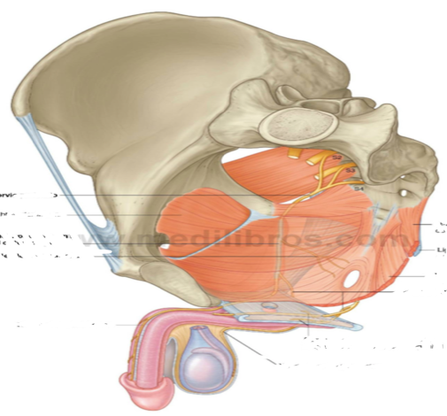
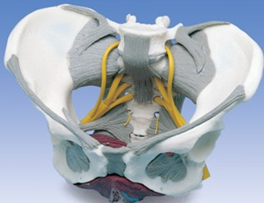
Anterior View of Male Pelvis | Superior View of Male Pelvis | Posterior View of Male Pelvis
c) Nerves • Pudendal nerve | c) Nerves • Pudendal nerve | c) Nerves • Pudendal nerve

Slide 11
ADDITIONAL INFORMATION • Pudendal nerve: It exits through the greater sciatic foramen, surrounds the sciatic spine and the spinous sacral ligament and traverses the minor sciatic foramen. It innervates the perineum and the lateral Wall of the pelvis. -Motor function: Innervates muscles of the perineum, external sphincters of the anus and urethra, levator anus muscle. -Sensitive Function: skin of the perineum, penis and clitoris.

Slide 12
4
LEARNIG OBJETIVE: Understand the location of the pelvic viscera and their peritoneal coverings | HOW TO MEET THE OBJETIVE?
The peritoneum is a layer of connective tissue that covers the pelvic viscera on its upper side and delimits the abdominal cavity. The content of pelvic viscera varies between men and women. | The student will have to see inside the pelvis and identify the arrangement of the structures, as well as their position within the pelvic cavity. It is important to represent how the peritoneum covers the pelvic viscera only on the upper surface, this to delimit the abdominal cavity.

Slide 13
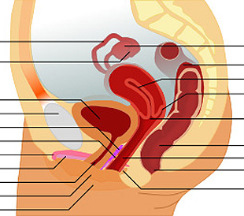
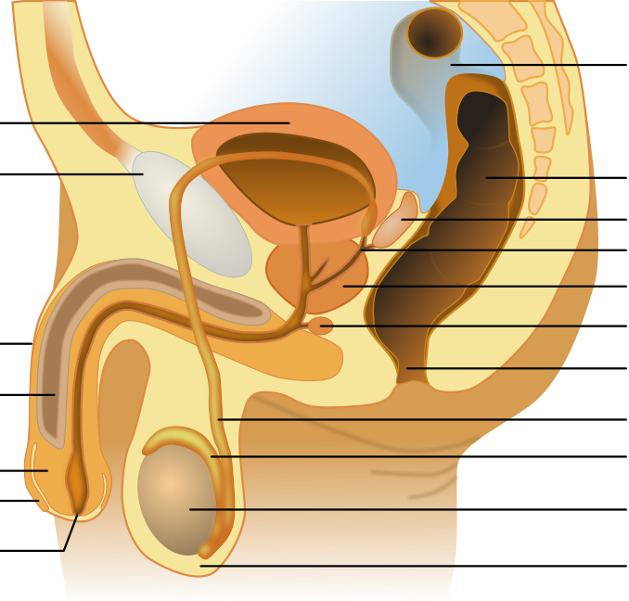
Female Pelvis | Male Pelvis
• Symphysis pubis Bladder Uterus rectum | • Symphysis pubis Bladder Prostate rectus

Slide 14
ADDITIONAL INFORMATION -Pubis Symphysis : The pubic symphysis a cartilaginous joint that sits between and joins the left and right superior rami of the pubic bones. -Bladder: The urinary bladder is a muscular sac in the pelvis, just above and behind the pubic bone. When empty, the bladder is about the size and shape of a pear. -Uterus: The uterus is an organ of the female reproductive system. It’s shaped like an upside-down pear and has thick walls. The uterus’s main function is to house and nourish a fetus until it’s ready for birth. The uterus sits in the middle of the pelvis, behind the bladder and in front of the rectum. -Prostate: The prostate is a walnut-sized gland located between the bladder and the penis. The prostate is just in front of the rectum. The urethra runs through the center of the prostate, from the bladder to the penis, letting urine flow out of the body. The prostate secretes fluid that nourishes and protects sperm. -Rectum: The rectum is a chamber that begins at the end of the large intestine, immediately following the sigmoid colon, and ends at the anus (see also Overview of the Anus and Rectum). Ordinarily, the rectum is empty because stool is stored higher in the descending colon.

Slide 15
Cap
structure | 1 | 2 | 3 | 4 | 5 | 6 | 7 | 8 | 9 | 10 | 11 | 12 | 13 | 14 | 15 | 16 | 17 | 18
Pelvis (without names) | + | + | + | + | + | + | + | + | + | + | + | + | + | + | + | + | + | +
Pelvis (with name) | - | + | - | - | - | - | - | - | - | - | - | - | - | - | - |  | - | -
Femur | - | - | + | - | - | - | + | - | - | - | - | - | - | + | - | + | - | -
Sacrospinous Lig. | - | - | - | + | - | - | + | - | - | - | - | - | - | + | + | + | - | -
Sacrotuberous Lig. | - | - | - | - | + | - | + | - | - | - | - | - | - | + | + | + | - | -
Obturatoor membren | - | - | - | - | - | + | + | - | - | - | - | - | - | + | - | + | - | -
iliacus | - | - | - | - | - | - | - | + | - | - | - | - | + | + | - | + | - | -
Levator ani | - | - | - | - | - | - | - | - | + | - | - | - | + | + | - | + | + | +
pirformis | - | - | - | - | - | - | - | - | - | + | - | - | + | + | - | + | + | +
Obturador internus | - | - | - | - | - | - | - | - | - | - | + | - | + | + | - | + | + | +
coccygeus | - | - | - | - | - | - | - | - | - | - | - | + | + | + | - | + | + | +
Pudendal nerve | - | - | - | - | - | - | - | - | - | - | - | - | - | - | + | + | - | -
Bladder | - | - | - | - | - | - | - | - | - | - | - | - | - | - | - | - | + | +
Uterus | - | - | - | - | - | - | - | - | - | - | - | - | - | - | - | - | + | -
Prostate | - | - | - | - | - | - | - | - | - | - | - | - | - | - | - | - | - | +
Rectum | - | - | - | - | - | - | - | - | - | - | - | - | - | - | - | - | + | +

Slide 16
perineum

Slide 17
Perineum | Deep Pouch | Sphinter urethrae muscle
 |  | Deep transverse perineal muscle
 |  | Urethra (membranous)
 |  | Vagina
 |  | Rectum
 |  | Bulbourethral gland
 |  | Ischioanal fossa
 |  | Internal pudendal artery and vena, pudendal nerve and branches
 | Perineal Membrane
 | Superficial pouch | Isquiocavernosus
 |  | Bulbocavernosus
 |  | Superficial transverse perineal muscle
 |  | Urethra (penile)
 |  | Clitoris and penis
 |  | Internal pudendal artery and vena, pudendal nerve and branches
This table is based on table 17: Divisions of the pelvis and peritoneum, on page 232 of the book Atlas of Anatomy, Second edition, Anne M. Gilroy.

Slide 18
5
LEARNIG OBJETIVE: Understand the anatomy of the pelvic floor. | HOW TO MEET THE OBJETIVE?
The pelvic floor covers the pelvis un the lower portion, its main function is to support the pelvic organs that can be divided into 3 compartments: -Previous: bladder and urethra -Medium: uterus and vagina, prostate and seminal vesicles -Later: straight | The student should observe the structures within the pelvic cavity and its relationship with the osseous structures that surround it.

Slide 19
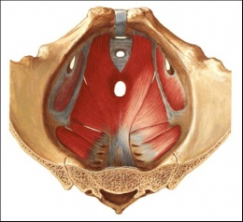
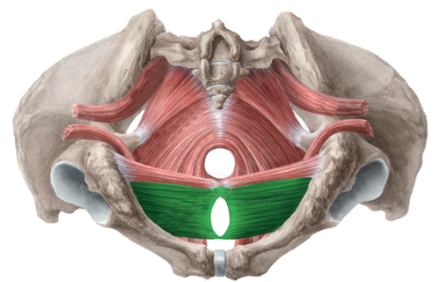
Inferior View of Perineum | Superior View of Perineum
-Deep transverse perineal -Superficial transverse perineal -elevator ani -piriformis -obturador internus -external anal sphincter -external urethral sphincter -bulbospongiosus -Ischiocavernosus | -elevator ani -coccygeus -piriformis -Obturador internus

Slide 20
ADDITIONAL INFORMATION - Deep transverse perineal muscle: The Deep transverse perineal muscle have origin in the internal surface of ischiopubic ramus and ischial tuberosity ; compressor urethrae portion only. Passes along superior posterior border of perineal membrane to perineal body and external anal sphincter for your insertion. -Superficial transverse perineal muscle: The superficial transverse perineal muscle is a narrow muscular slip, which passes more or less transversely across the perineal space in front of the anus. -ORIGIN: Ischial ramus -INSERTION: perineal body -INNERVATION: S2-S4 -ACTION: Holds the pelvic organs in place, closes the urethra -Anal sphincter: The anal sphincter is a group of muscles at the end of the rectum that surrounds the anus and controls the release of stool, thereby maintaining continence. There are two sphincter muscles: one is internal and one is external. The external muscle helps maintain continence and keep stool in the rectum. -Internal Sphinter urethrae muscle: The internal sphincter muscle of urethra: located at the bladder's inferior end and the urethra's proximal end at the junction of the urethra with the urinary bladder. The internal sphincter is a continuation of the detrusor muscle and is made of smooth muscle, therefore it is under involuntary or autonomic control. This is the primary muscle for prohibiting the release of urine. -Bulbourethral gland: The Bulbourethral gland are two pea-shaped glands in the male, located beneath the prostate gland at the beginning of the internal portion of the penis; they add fluids to semen during the process of ejaculation. -Ischioanal fossa: The potential spaces surrounding the anal canal, in the anal triangle region, located between the skin of the anal region and the pelvic diaphragm. The ischioanal fossa is somewhat prismatic in shape, with its base directed to the surface of the perineum, and its apex at the line of the perineum, and its apex at the line of meeting of the obturator and anal fasciae.

Slide 21
5
LEARNIG OBJETIVE: Define the urogenital and anal triangle. | HOW TO MEET THE OBJETIVE?
The urogenital triangle is located in the anterior portion of the pelvic floor and supports the root of the external genitalia. It is composed by the perineal membrane and the deep perineal space The anal triangle is located in the posterior portion of the pelvic floor and supports the anal canal. | Students will have to mobilize the pelvis to identify the structures that make up the urogenital triangle and the anal triangle and understand the anatomical position and the relationship with other structures.

Slide 22
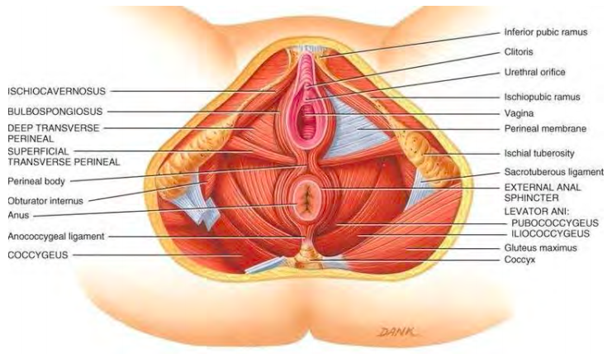
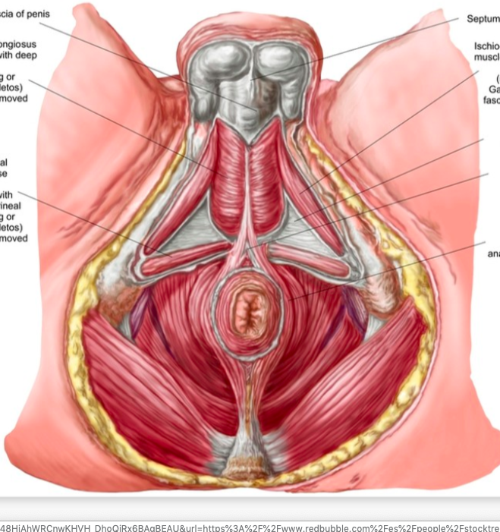
Female Perineum |  | Male Pelvis
-Deep transverse perineal -Superficial transverse perineal -elevator ani -piriformis -obturador internus -Anus -anococcygeal ligament -coccygeus -external anal sphincter | -external urethral sphincter -bulbospongiosus -Ischiocavernosus -clitoris -Urethral orifice -vagina -perineal membrane -sacrotuberous ligament | -bulbospongiosus -Ischiocavernosus -perineal membrane -Deep transverse perineal -bulb of penis | -Superficial transverse perineal -sacrotuberous ligament -elevator ani -Anus -anococcygeal ligament -coccygeus -external anal sphincter

Slide 23
ADDITIONAL INFORMATION -Anal sphincter: The anal sphincter is a group of muscles at the end of the rectum that surrounds the anus and controls the release of stool, thereby maintaining continence. There are two sphincter muscles: one is internal and one is external. The external muscle helps maintain continence and keep stool in the rectum. -Internal Sphinter urethrae muscle: The internal sphincter muscle of urethra: located at the bladder's inferior end and the urethra's proximal end at the junction of the urethra with the urinary bladder. The internal sphincter is a continuation of the detrusor muscle and is made of smooth muscle, therefore it is under involuntary or autonomic control. This is the primary muscle for prohibiting the release of urine. -Bulbourethral gland: The Bulbourethral gland are two pea-shaped glands in the male, located beneath the prostate gland at the beginning of the internal portion of the penis; they add fluids to semen during the process of ejaculation. -Ischioanal fossa: The potential spaces surrounding the anal canal, in the anal triangle region, located between the skin of the anal region and the pelvic diaphragm. The ischioanal fossa is somewhat prismatic in shape, with its base directed to the surface of the perineum, and its apex at the line of the perineum, and its apex at the line of meeting of the obturator and anal fasciae.

Slide 24
5
LEARNIG OBJETIVE: Differentiate the components of the deep perineal pouch in male and female | HOW TO MEET THE OBJETIVE?
The content varies depending on whether it is male or female, since it supports the sexual organs. Deep perineal pouch Male: membranous urethra, Deep transverse perinei, Sphincter urethrae (external), Bulbourethral glands, internal pudendal vessels, dorsal nerve of penis. Female: Proximal part of uretha, External urethral sphincter muscle, Deep transverse perineal muscles, Related vessels and nerves, Deep artery of clítoris, dorsal arteriy of clítoris, Artery to bulb of vestibule, Urethral artery, dorsal nerve of clítoris. | Students should be able to see from the bottom view, the structures that cross the pelvic floor, since these vary between men and women, the order of the structures changes, that is why students should have access to be able to change from male to female. woman, to be able to observe the difference.

Slide 25
Female Perineum |  | Male Pelvis
-Deep transverse perineal -Superficial transverse perineal -elevator ani -piriformis -obturador internus -Anus -anococcygeal ligament -coccygeus -external anal sphincter | -external urethral sphincter -bulbospongiosus -Ischiocavernosus -clitoris -Urethral orifice -vagina -perineal membrane -sacrotuberous ligament | -bulbospongiosus -Ischiocavernosus -perineal membrane -Deep transverse perineal -bulb of penis | -Superficial transverse perineal -sacrotuberous ligament -elevator ani -Anus -anococcygeal ligament -coccygeus -external anal sphincter

Slide 26
ADDITIONAL INFORMATION -Urethra: Duct that transmits urine from the bladder to the exterior of the body during urination. The urethra is held closed by the urethral sphincter, a muscular structure that helps keep urine in the bladder until voiding can occur. -Portions of the female urethra: intrapelvic urethra and intraperineal urethra -Portions of the male urethra: Prostatic urethra, membranous urethra, spongy urethra -Clitoris: A small mass of erectile tissue in the female that is situated at the anterior apex of the vulva, near the meeting of the labia majora (vulvar lips). The clitoris is highly sensitive to stimulation during sex. -Penis: An external male reproductive organ, it contains a tube called the urethra which carries semen and urine to the outside of the body. The parts of the penis are the base, shaft, glans, and foreskin. The Tirssue, and erectile tissue (corpus cavernosum and corpus spongiosum). The urethra passes from the bladder to the tip of the penis. - Perineal Membrane: The perineal membrane is a thin triangular horizontal layer of dense tough fascia in the perineum the dividing the urogenital triangle into the superficial (inferior) and deep (superior) perineal pouches. It attaches to the inferior margins of the ischiopubic rami, enclosing the anterior portion of the pelvic outlet. Its posterior margin is thickened and connects to the transverse perineal ligament which contains the perineal body in the midline, a condensation of fibromuscular tissue with various muscular attachments.

Slide 27
5
LEARNIG OBJETIVE: Define the border and the extent of the ischioanal fossa | HOW TO MEET THE OBJETIVE?
The ischioal fossa is a wedge-shaped space located between the levator ani muscle and the wall of the pelvis on each side. The ischioanal fossae allow the movement of the pelvic diaphragm and the expansion of the anal canal during defecatio. Contents -ischioanal (or ischiorectal) fat pad -pudendal canal: lies in a fibrous sheath on the lateral wall and itself contains the pudendal nerve and internal pudendal vessels -inferior rectal branches of the pudendal nerve -posterior scrotal (labral) nerves and vessels -perineal branch of S4 -perforating cutaneous nerve -lymphatic trunks | Students should be able to see the back of the pelvis, and see the structures that limit the ischioanal fossa, as well as see its fat content

Slide 28
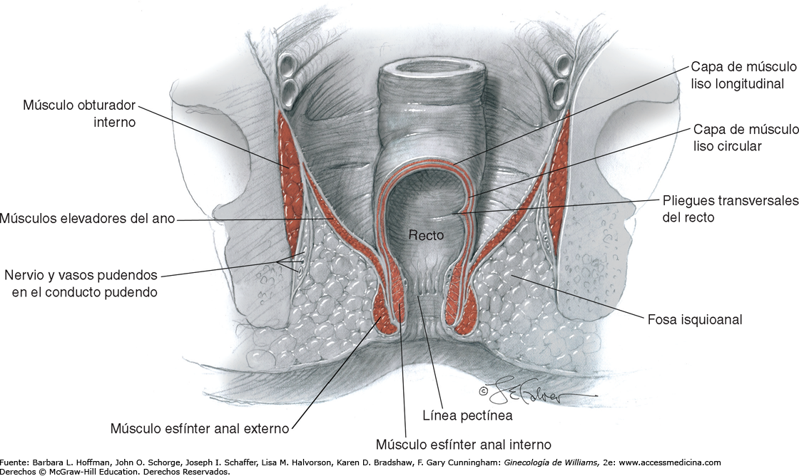
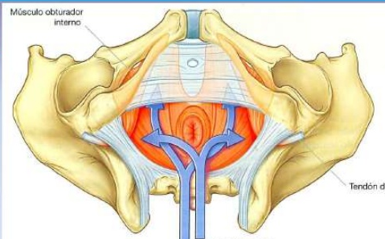
Posterior View of Male Pelvis | Posterior View of Male Pelvis
-Sacrospinous ligament -Sacrotuberous ligament -ischioanal fossa -coccys -anus | -ischioanal fossa -Sacrum -coccys -ischiatic tuberosity -iliacum

Slide 29
5
LEARNIG OBJETIVE: Differentiate the contents of the male and female superficial perineal pouch | HOW TO MEET THE OBJETIVE?
The content varies depending on whether it is male or female, since it supports the sexual organs. Male: Bulbospongiosus muscle, Ischiocavernosus muscle, Anal Sphincter, Deep Transverse Perineal, Anal sphincter, Deep Transverse Perineal, superficial transverse perineal muscle. Female: Root of the clítoris and muscle associated with it, bulbs of the vestibule and surrounding muscle, Superficial transverse perineal muscle, Branches of the perineal branch, transverse perineal branches of the perineal branch, posterior labial branch of perineal branch of the pudendal nerves, perineal branch of posterior cutaneous nerve of thigh, greater vestibular glands. | Students should be able to see from the bottom view, the structures that cross the pelvic floor, since these vary between men and women, the order of the structures changes, that is why students should have access to be able to change from male to female. woman, to be able to observe the difference.

Slide 30
Female Perineum |  | Male Pelvis
-Root of the clítoris and muscle associated with it, -Bulbs of the vestibule and surrounding muscle -Superficial transverse perineal muscle -Branches of the perineal branch | -Vestibular glands -Great -Perineal branch of posterior cutaneous nerve of thighe -Posterior labial branch of perineal branch of the pudendal nerves -Transverse perineal branches of the perineal branch | -Bulbospongiosus muscle -Ischiocavernosus muscle -Anal Sphincter -Deep Transverse Perineal | -Anal sphincter -Deep Transverse Perineal -superficial transverse perineal muscle.

Slide 31
6
LEARNIG OBJETIVE: Understand the arterial and nerve supply to the perineum | HOW TO MEET THE OBJETIVE?
The pudendal nerve gives innervation to the perineum through its branches. It is divided into the inferior anal nerve, the perineal nerve and the dorsal nerve of the penis or clitoris. Each branch of the pudendal nerve is accompanied by branches of the internal pudendal artery that irrigates the area. | Students can observe the path of the pudendal nerve and its branches that invert the perineum. Students can observe the path taken by the arteries to follow the path of the pudendal nerve and its branches.

Slide 32
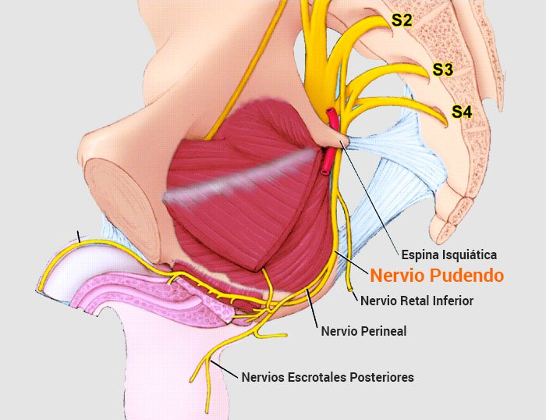
Inferior View of Perineum | Posterior View of Perineum
-Pudendal nerve | Pudendal nerve

Slide 33
 | Cap
 | structure | 1 | 2 | 3 | 4 | 5 | 6 | 7 | 8 | 9 | 10 | 11 | 12 | 13 | 14 | 15 | 16 | 17 | 18 | 19
 | Pelvis (without names) | + | + | + | + | + | + | + | + | + | + | + | + | + | + | + | + | + | + | +
Deep Pouch | Sphinter urethrae muscle | - | + | - | - | - | - | - | - | - | + | - | + | - | - | - | - | - | - | +
 | Deep transverse perineal muscle | - | - | + | - | - | - | - | - | - | + | - | + | - | - | - | - | - | - | +
 | Urethra (membranous) | - | - | - | + | - | - | - | - | - | + | - | + | - | - | - | - | - | - | +
 | Vagina | - | - | - | - | + | - | - | - | - | + | - | + | - | - | - | - | - | - | +
 | Rectum | - | - | - | - | - | + | - | - | - | + | - | + | - | - | - | - | - | - | +
 | Bulbourethral gland | - | - | - | - | - | - | + | - | - | + | - | + | - | - | - | - | - | - | +
 | Ischioanal fossa | - | - | - | - | - | - | - | + | - | + | - | + | - | - | - | - | - | - | +
 | Internal pudendal artery and vena, pudendal nerve and branches | - | - | - | - | - | - | - | - | + | + | - | + | - | - | - | - | - | - | +
 | Perineal Membrane | - | - | - | - | - | - | - | - | - | - | + | + | - | - | - | - | - | - | +
Superficial pouch | Isquiocavernosus | - | - | - | - | - | - | - | - | - | - | - | - | + | - | - | - | - | + | +
 | Bulbocavernosus | - | - | - | - | - | - | - | - | - | - | - | - | - | + | - | - | - | + | +
 | Superficial transverse perineal muscle | - | - | - | - | - | - | - | - | - | - | - | - | - | - | + | - | - | + | +
 | Urethra (penile) | - | - | - | - | - | - | - | - | - | - | - | - | - | - | - | + | - | + | +
 | Clitoris and penis | - | - | - | - | - | - | - | - | - | - | - | - | - | - | - | - | + | + | +

Slide 34
-Internal Sphinter urethrae muscle: The internal sphincter muscle of urethra: located at the bladder's inferior end and the urethra's proximal end at the junction of the urethra with the urinary bladder. The internal sphincter is a continuation of the detrusor muscle and is made of smooth muscle, therefore it is under involuntary or autonomic control. This is the primary muscle for prohibiting the release of urine. -Deep transverse perineal muscle: The Deep transverse perineal muscle have origin in the internal surface of ischiopubic ramus and ischial tuberosity ; compressor urethrae portion only. Passes along superior posterior border of perineal membrane to perineal body and external anal sphincter for your insertion. Origin: Internal surface of isquiopubic ramus and ischial tuberosity; compressor urethrae portion only. -Vagina: The vagina is an elastic, muscular canal with a soft, flexible lining that provides lubrication and sensation. The vagina connects the uterus to the outside world. The vulva and labia form the entrance, and the cervix of the uterus protrudes into the vagina, forming the interior end. Rectum: The rectum is a part of the lower gastrointestinal tract. The rectum is a continuation of the sigmoid colon, and connects to the anus. The rectum follows the shape of the sacrum and ends in an expanded section called the rectal ampulla, where feces are stored before their release via the anal canal. Bulbourethral gland: The Bulbourethral gland are two pea-shaped glands in the male, located beneath the prostate gland at the beginning of the internal portion of the penis; they add fluids to semen during the process of ejaculation. Ischioanal fossa: The potential spaces surrounding the anal canal, in the anal triangle region, located between the skin of the anal region and the pelvic diaphragm. The ischioanal fossa is somewhat prismatic in shape, with its base directed to the surface of the perineum, and its apex at the line of the perineum, and its apex at the line of meeting of the obturator and anal fasciae. Perineal Membrane: The perineal membrane is a thin triangular horizontal layer of dense tough fascia in the perineum the dividing the urogenital triangle into the superficial (inferior) and deep (superior) perineal pouches. It attaches to the inferior margins of the ischiopubic rami, enclosing the anterior portion of the pelvic outlet. Its posterior margin is thickened and connects to the transverse perineal ligament which contains the perineal body in the midline, a condensation of fibromuscular tissue with various muscular attachments.

Slide 35
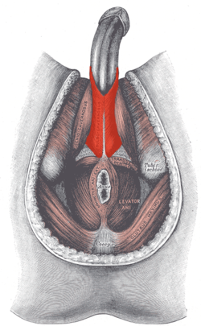
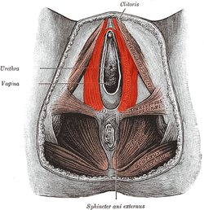
-Anal sphincter: The anal sphincter is a group of muscles at the end of the rectum that surrounds the anus and controls the release of stool, thereby maintaining continence. There are two sphincter muscles: one is internal and one is external. The external muscle helps maintain continence and keep stool in the rectum. -Ischiocavernosus muscle: Ischiocavernosus is a bilateral perineal muscle in both males and females. In males, it arises from the medial aspect of the ischial tuberosity and more anteriorly, from the ischial ramus. It inserts into the aponeurosis over the medial and lateral sides of the crus penis. It action is to facilitate the maintainance of an erection. In females, ischiocavernosus has a similar origin but it inserts into the crura of the clitoris. Its function is similar: to retard venous return so erecting the clitoris. -ORIGIN: Ischial ramus -INSERTION: Crus of clitoris or penis -INNERVATION: S2-S4 -ACTION: Maintains erection by squeezing blood into corpus cavernosus of clitoris or penis -Bulbocavernosus: The bulbocavernosus is one of the superficial muscles of the perineum. It has a slightly different origin, insertion and function in males and females. In males, it covers the bulb of the penis. In females, it covers the vestibular bulb. In both sexes, it is innervated by the deep/muscular branch of the perineal nerve, which is a branch of the pudendal nerve. -ORIGIN: Women: Tendon center of the perineum; Men: Tendon center of the perineum and middle raphe. -INSERTION: Women: hall bulb, perineal membrane, body of the clitoris and corpora cavernosa; Men: bulbousponjoso, perineal membrane, corpora cavernosa. -INNERVATION: S2-S4 -ACTION: Women: Compresses greater vestibular gland; Men: Assists in erection.

Slide 36
-Superficial transverse perineal muscle: The superficial transverse perineal muscle is a narrow muscular slip, which passes more or less transversely across the perineal space in front of the anus. -ORIGIN: Ischial ramus -INSERTION: perineal body -INNERVATION: S2-S4 -ACTION: Holds the pelvic organs in place, closes the urethra -Urethra: Urethra, duct that transmits urine from the bladder to the exterior of the body during urination. The urethra is held closed by the urethral sphincter, a muscular structure that helps keep urine in the bladder until voiding can occur. -Portions of the female urethra: intrapelvic urethra and intraperineal urethra -Portions of the male urethra: Prostatic urethra, membranous urethra, spongy urethra -Clitoris: A small mass of erectile tissue in the female that is situated at the anterior apex of the vulva, near the meeting of the labia majora (vulvar lips). The clitoris is highly sensitive to stimulation during sex. -Penis: An external male reproductive organ, it contains a tube called the urethra which carries semen and urine to the outside of the body. The parts of the penis are the base, shaft, glans, and foreskin. The Tirssue, and erectile tissue (corpus cavernosum and corpus spongiosum). The urethra passes from the bladder to the tip of the penis. -Pudendal nerve: It exits through the greater sciatic foramen, surrounds the sciatic spine and the spinous sacral ligament and traverses the minor sciatic foramen. It innervates the perineum and the lateral Wall of the pelvis. -Motor function: Innervates muscles of the perineum, external sphincters of the anus and urethra, levator anus muscle. -Sensitive Function: skin of the perineum, penis and clitoris.

